Slide 1
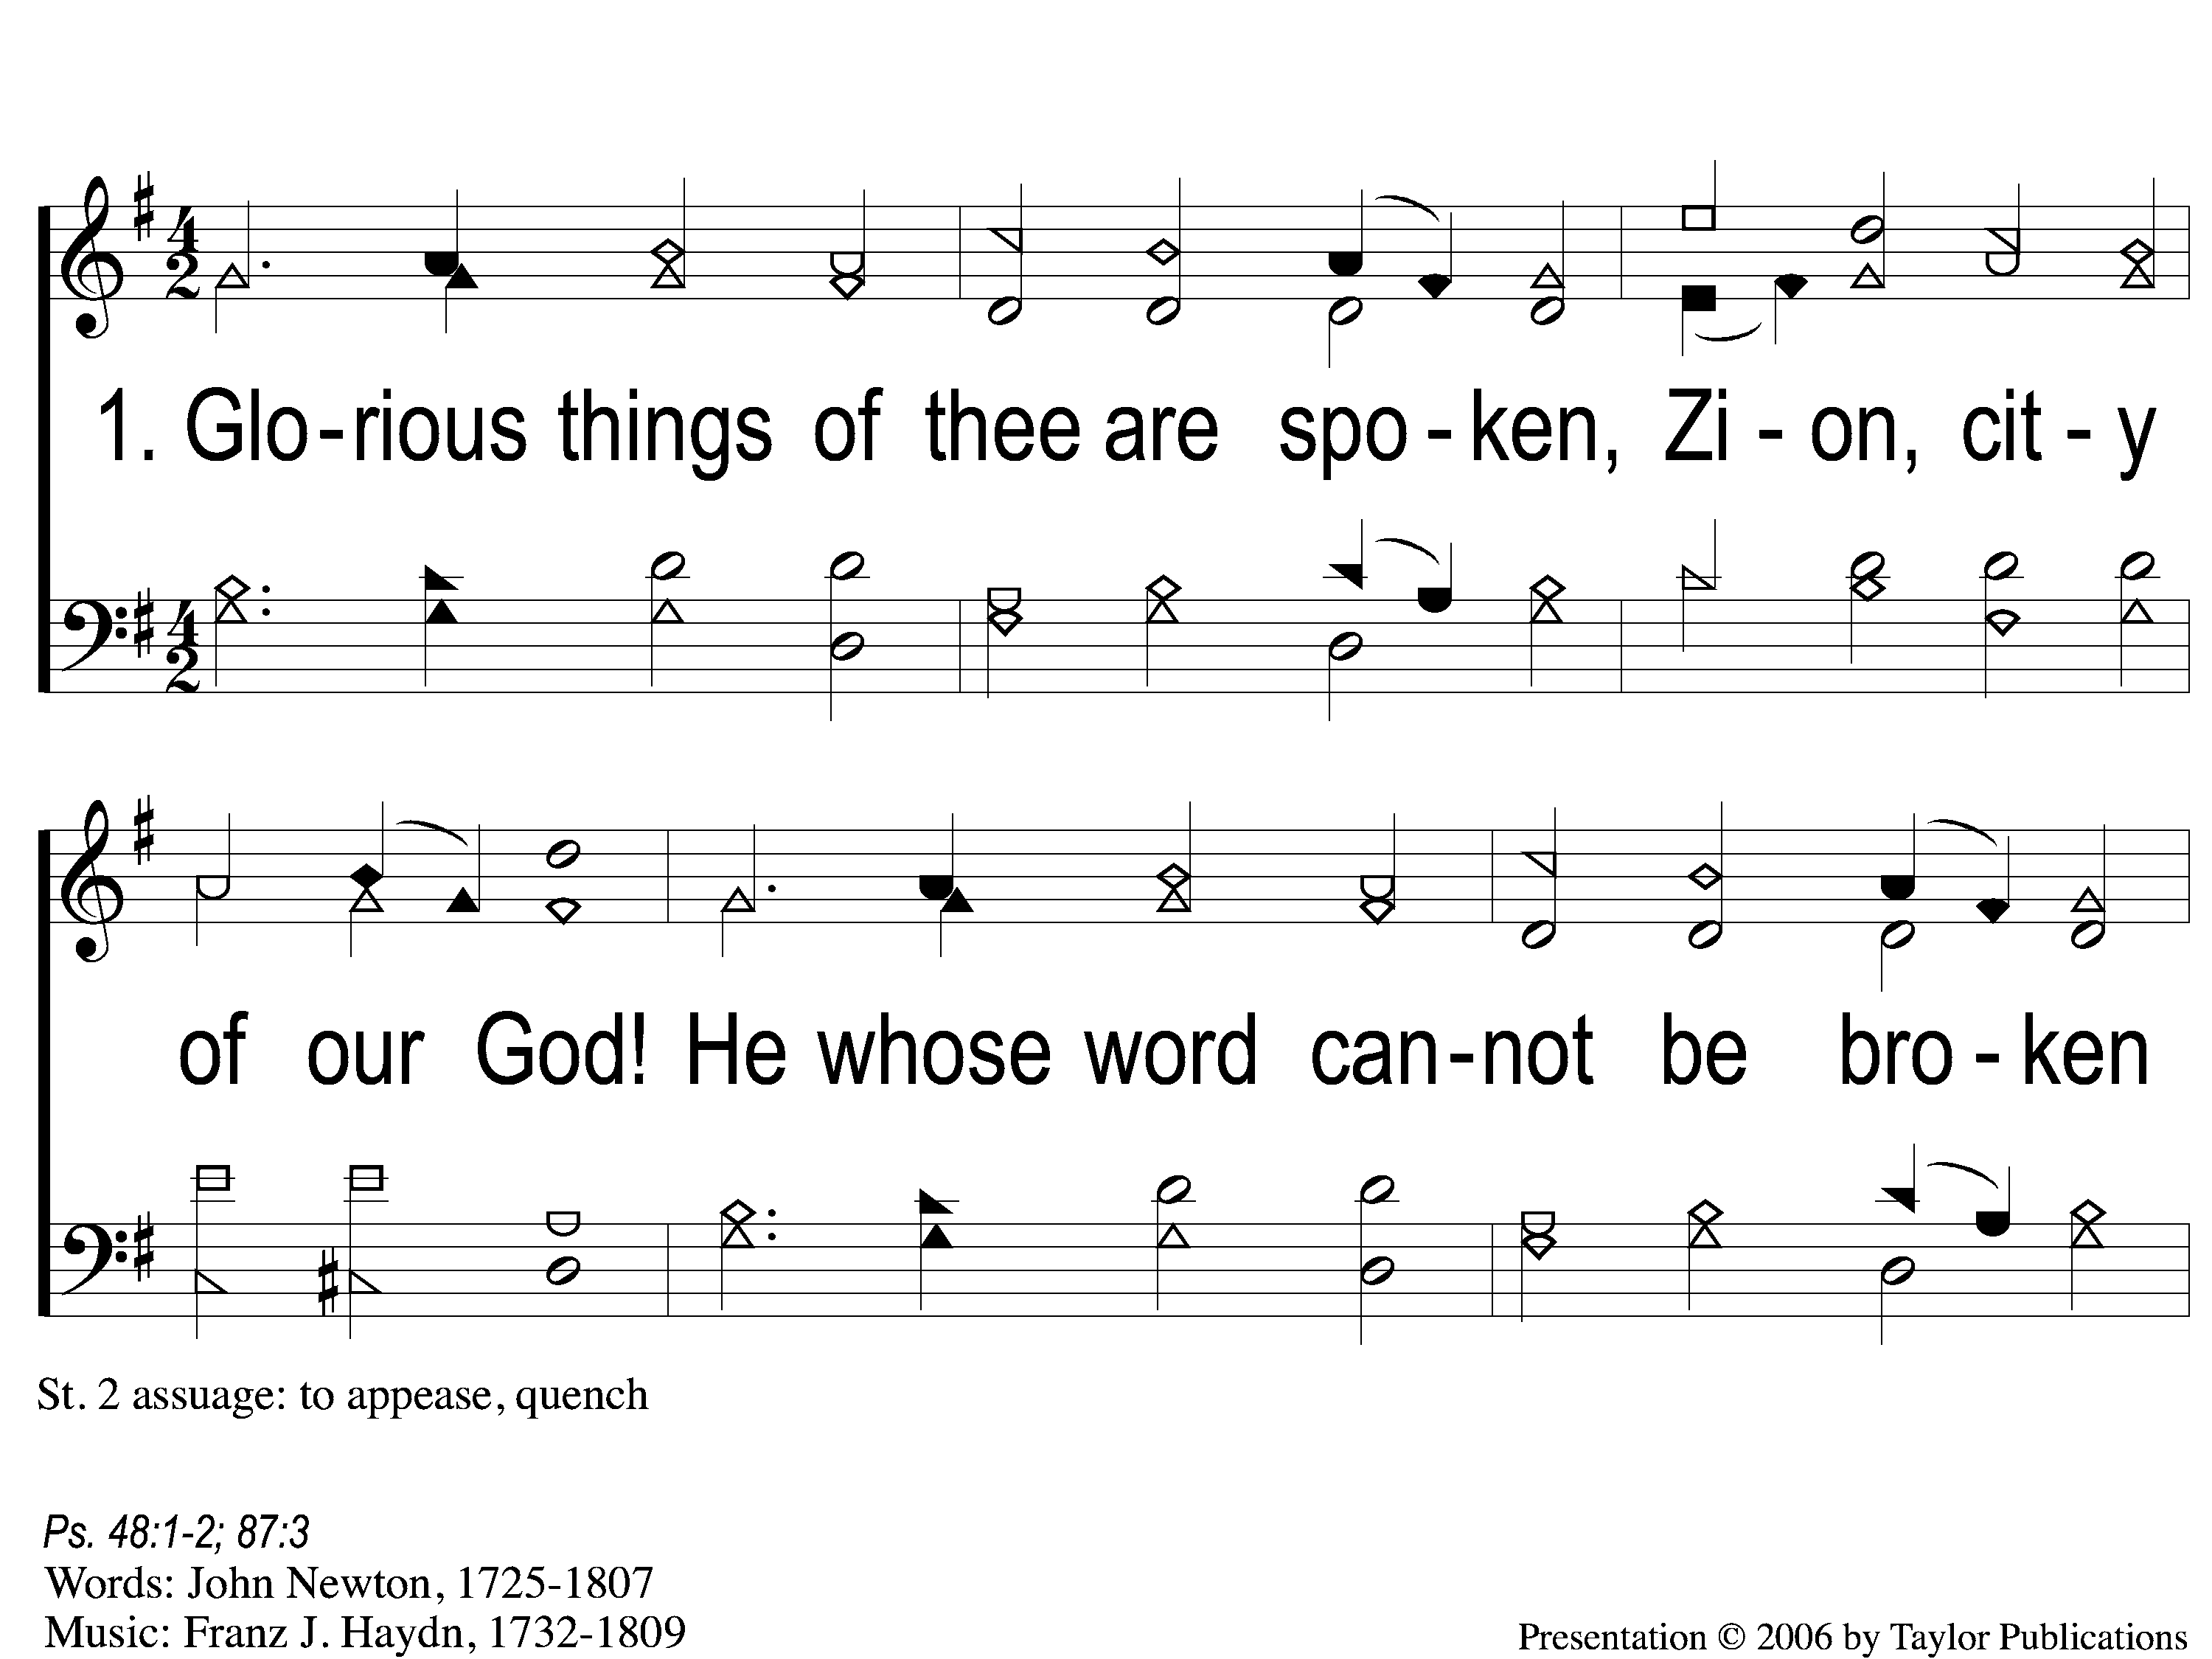
1-1 Glorious Things of Thee Are Spoken
Glorious Things Of Thee Are Spoken
138

Slide 2
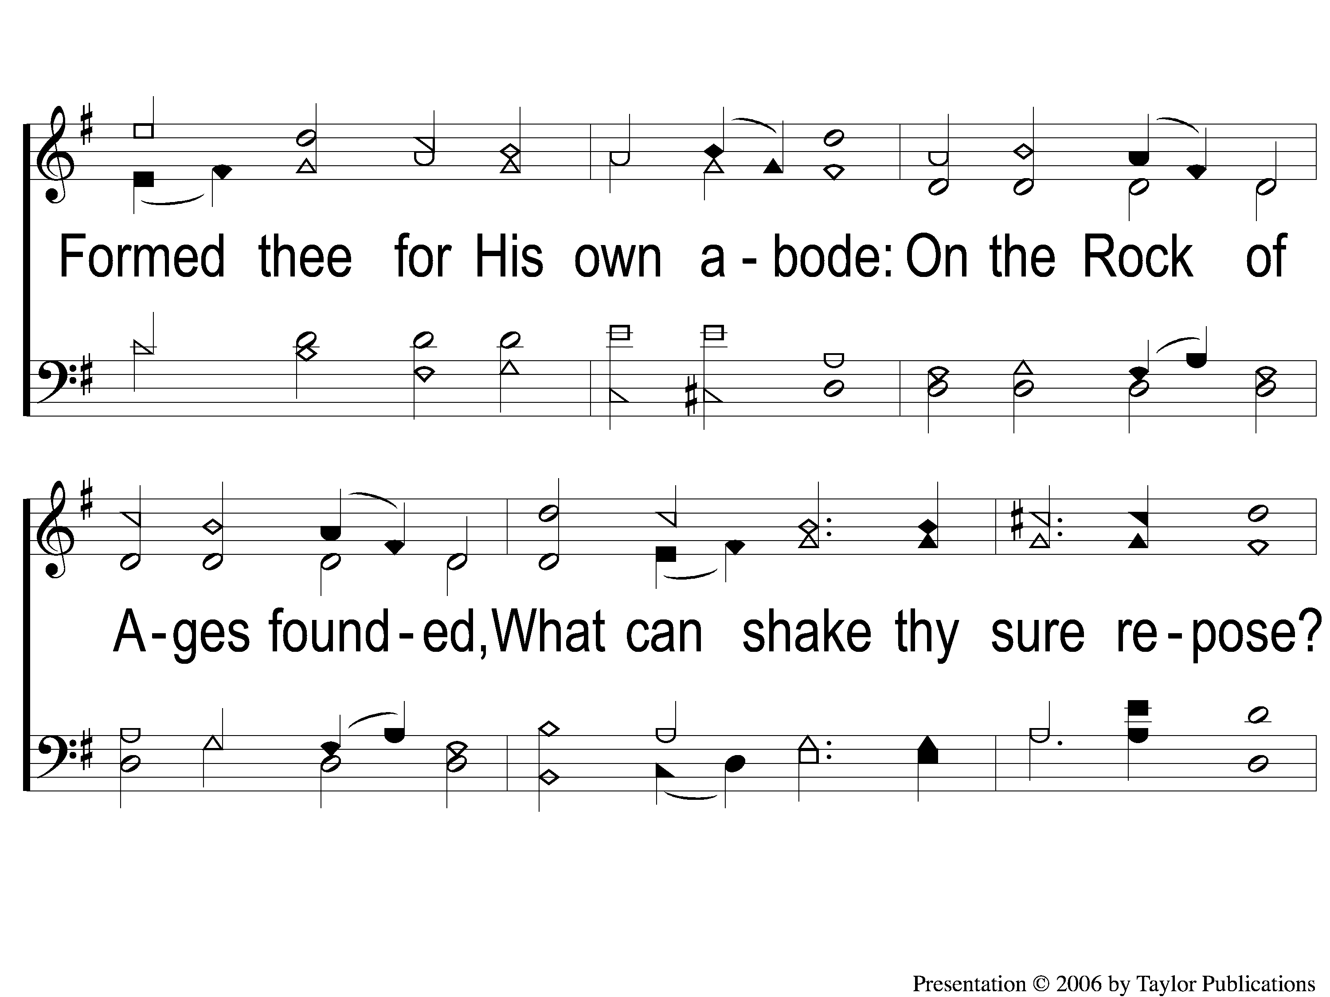
1-2 Glorious Things of Thee Are Spoken
Glorious Things Of Thee Are Spoken
138

Slide 3
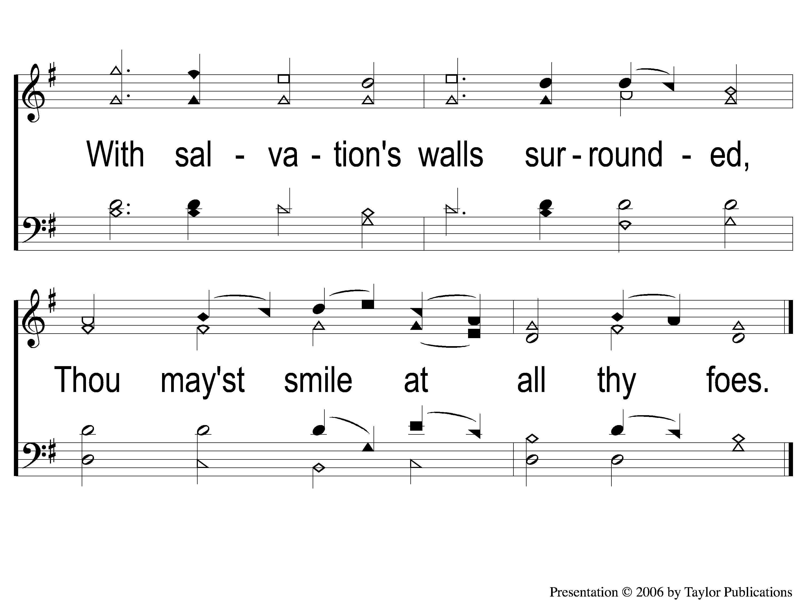
1-3 Glorious Things of Thee Are Spoken
Glorious Things Of Thee Are Spoken
138

Slide 4
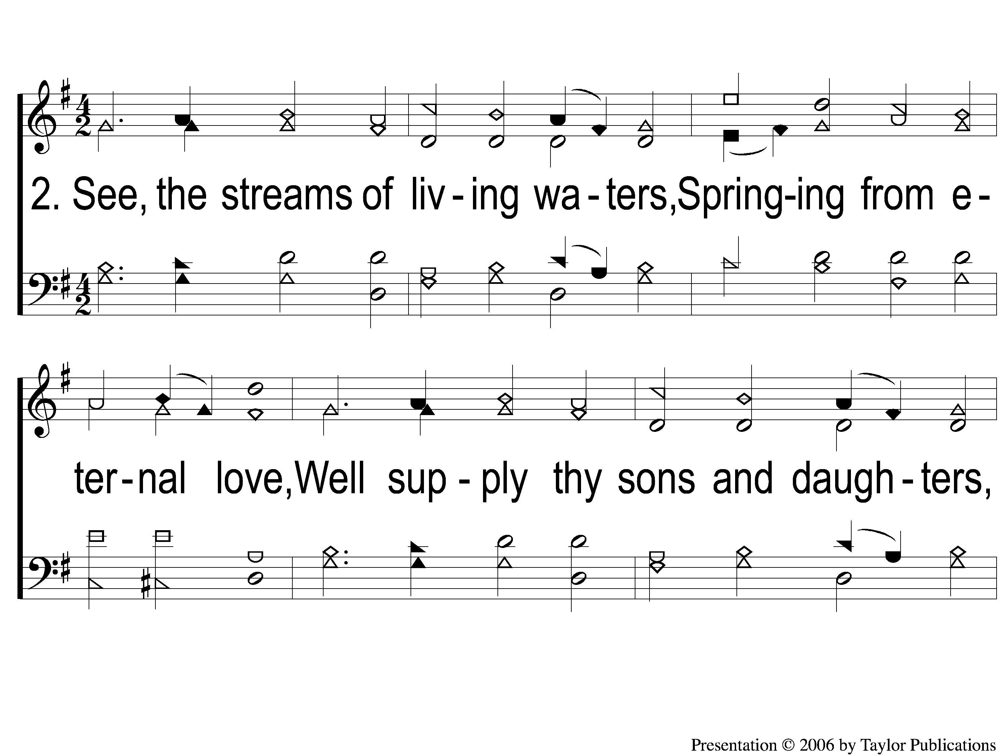
2-1 Glorious Things of Thee Are Spoken
Glorious Things Of Thee Are Spoken
138

Slide 5
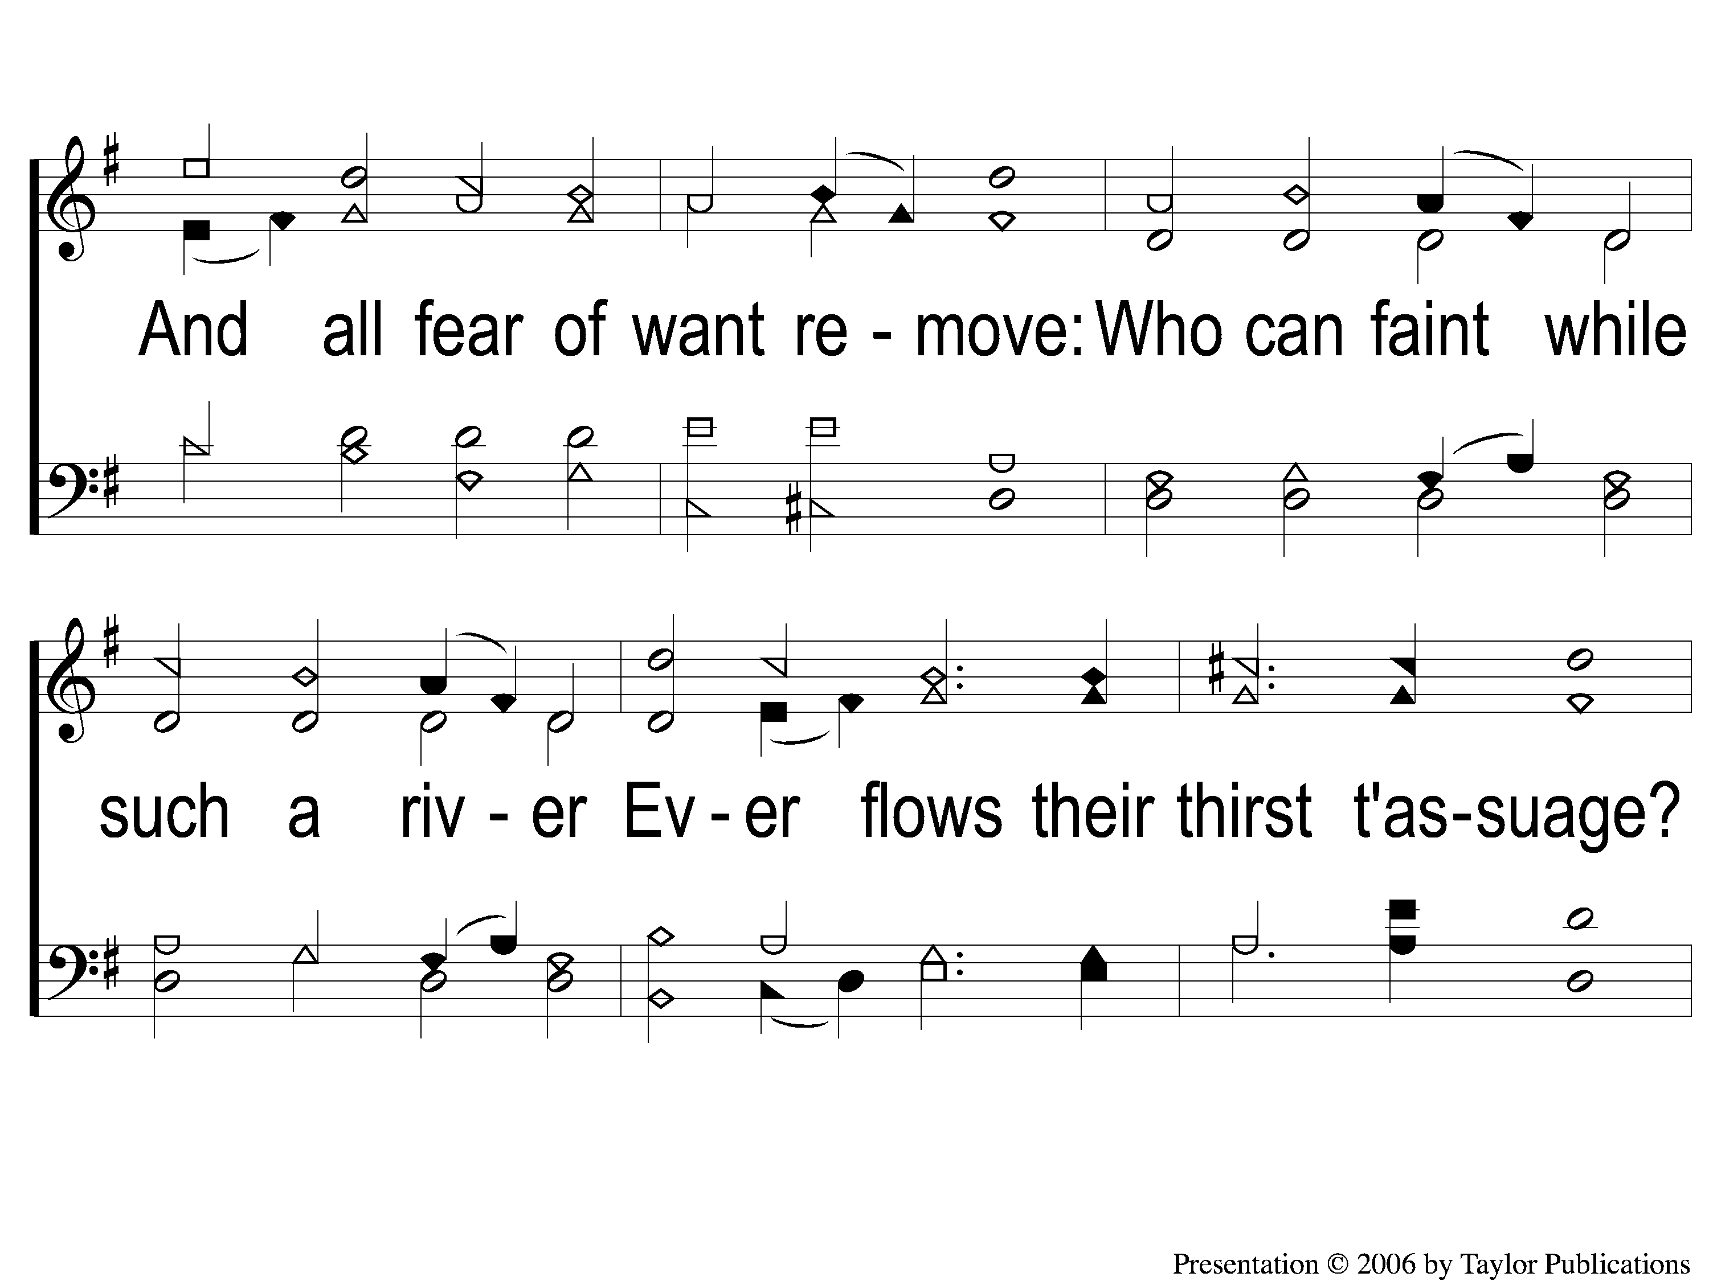
2-2 Glorious Things of Thee Are Spoken
Glorious Things Of Thee Are Spoken
138

Slide 6
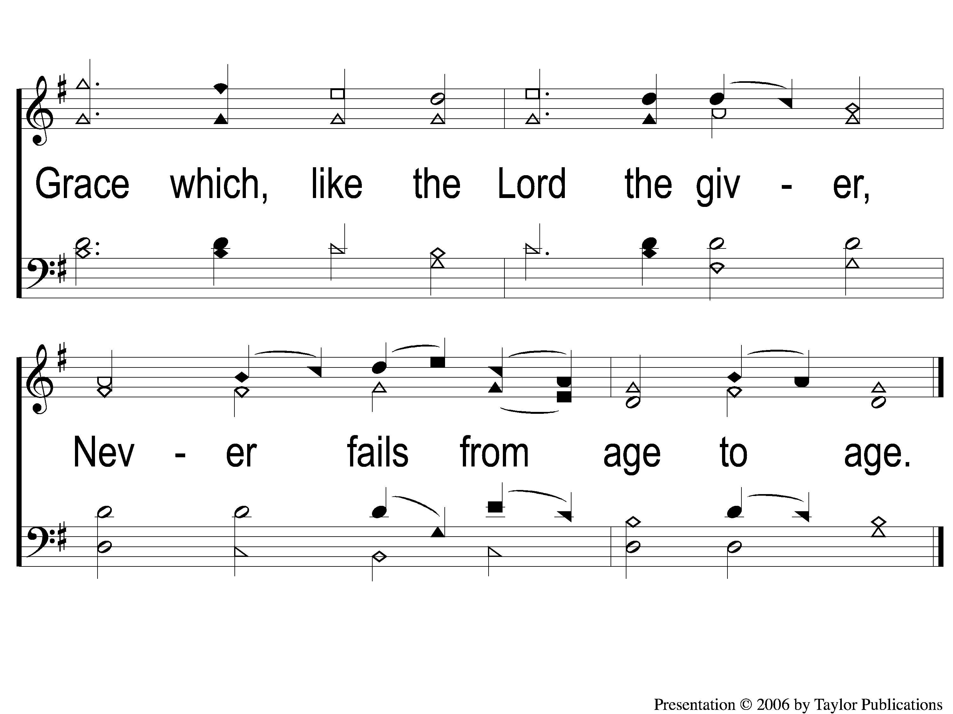
2-3 Glorious Things of Thee Are Spoken
Glorious Things Of Thee Are Spoken
138

Slide 7
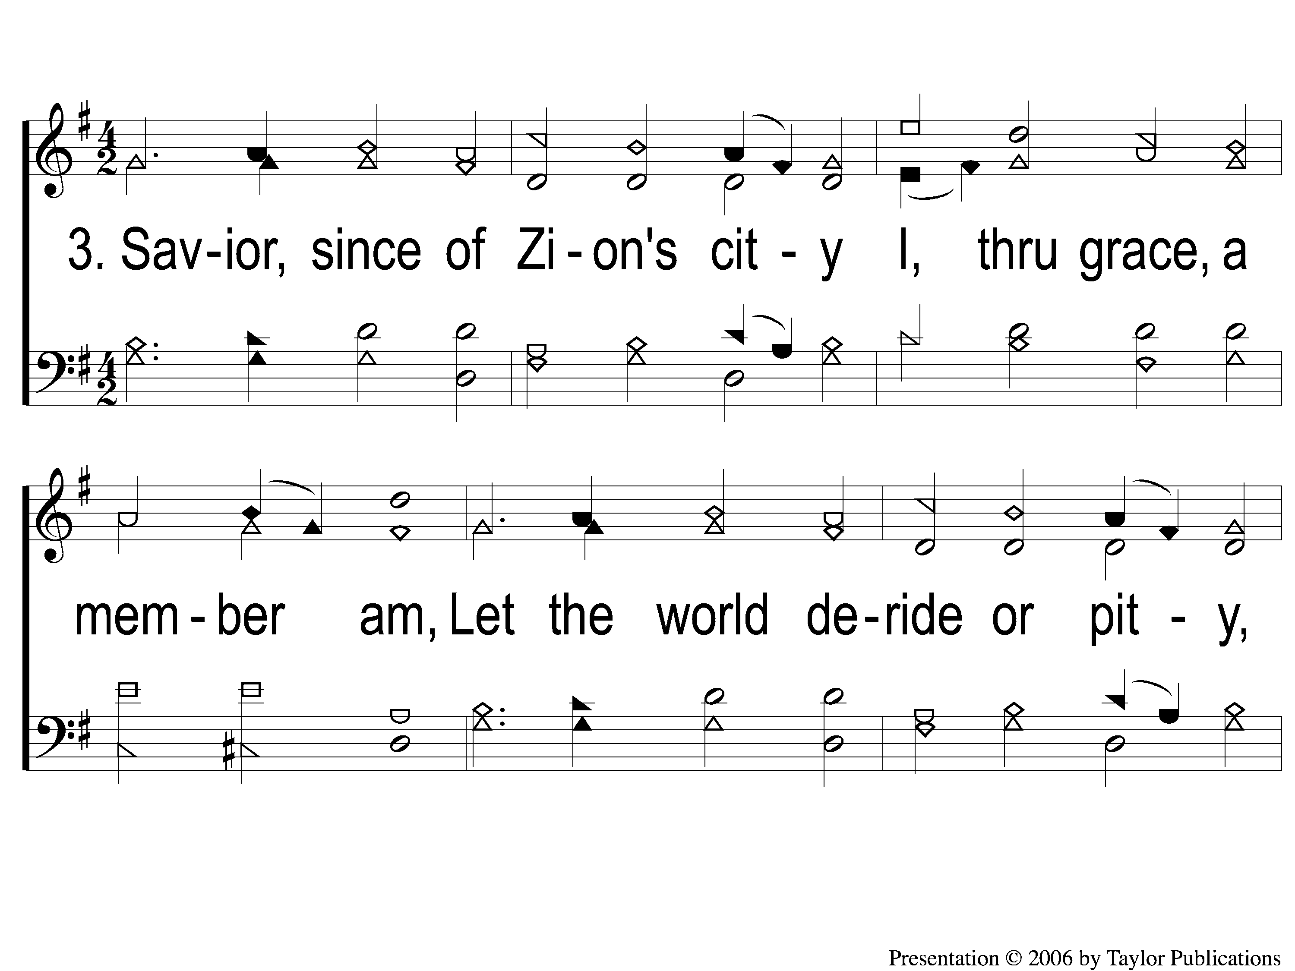
3-1 Glorious Things of Thee Are Spoken
Glorious Things Of Thee Are Spoken
138

Slide 8
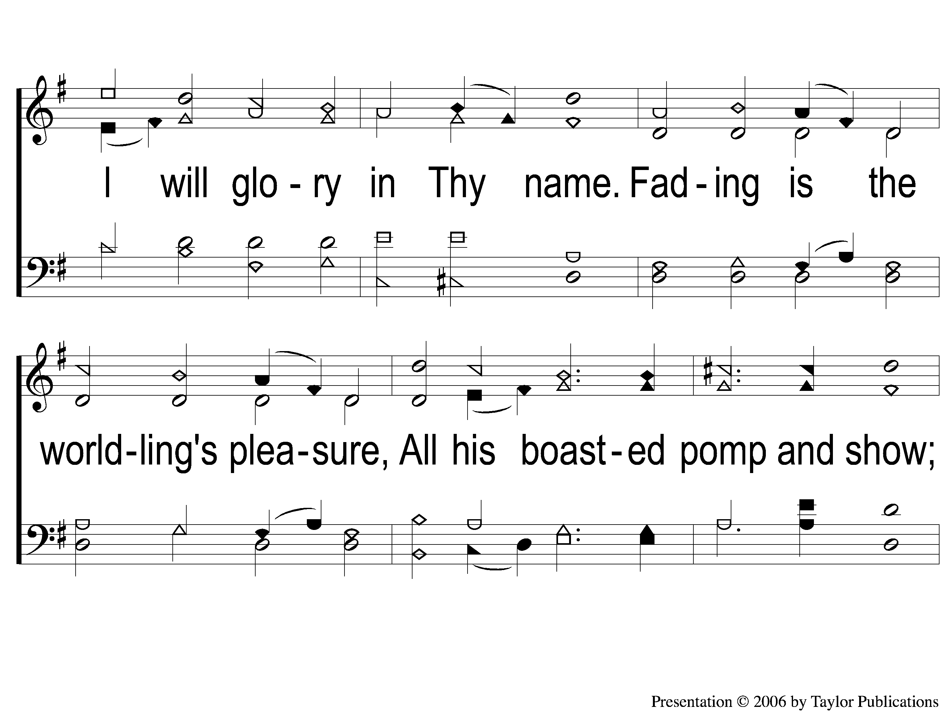
3-2 Glorious Things of Thee Are Spoken
Glorious Things Of Thee Are Spoken
138

Slide 9
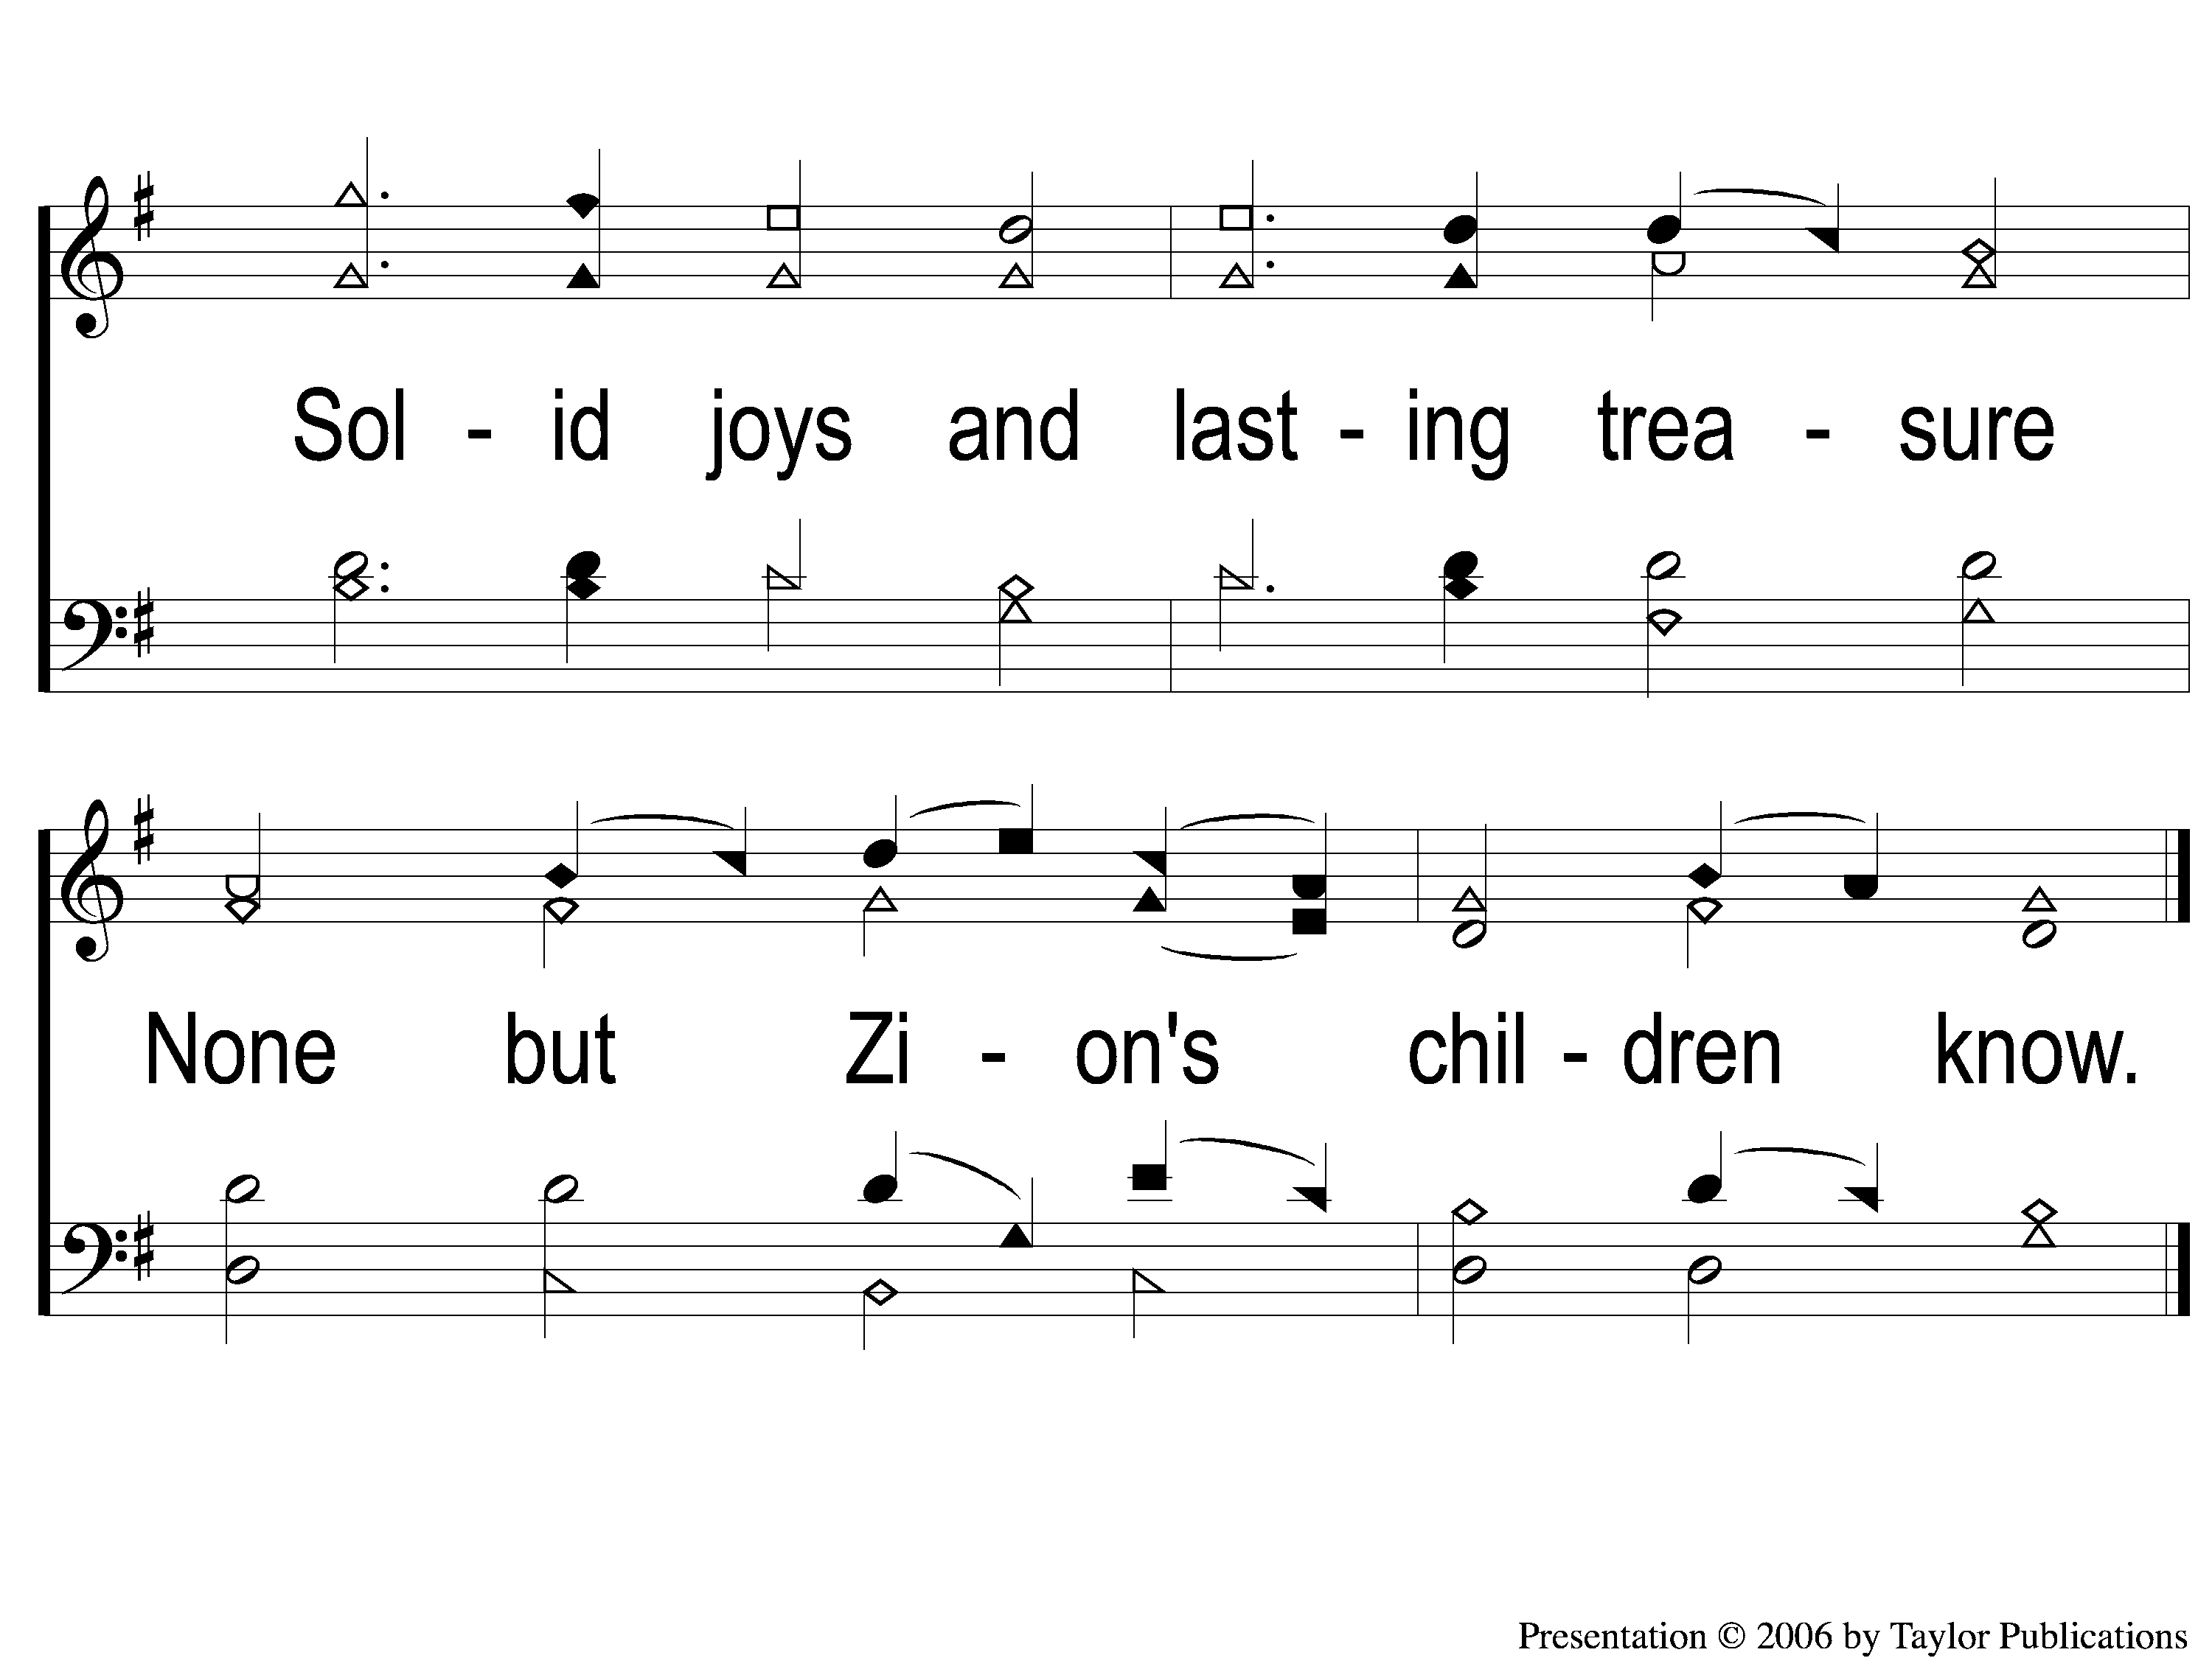
3-3 Glorious Things of Thee Are Spoken
Glorious Things Of Thee Are Spoken
138

